Slide 1

ANALYSIS AND INSIGHTS OF CUSTOMERS FEEDBACK AND REVIEW

Slide 2
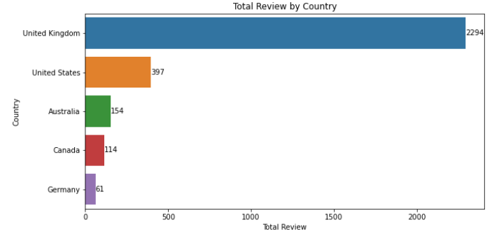
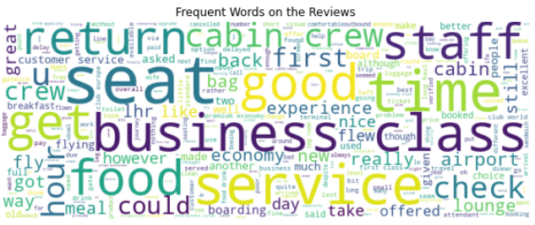
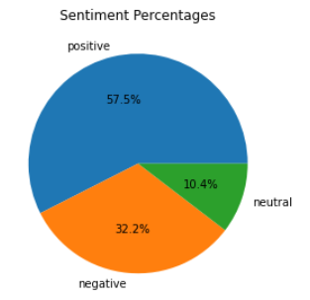
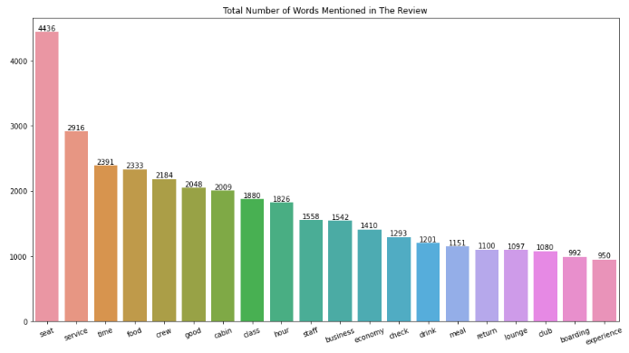
Total Review 3632
CUSTOMERS FEEDBACK AND REVIEW performance
Avg. Overal Rating 4.76/10
Total Country Reviews From 71 Countries
Country most Reviews From United Kingdom
The total number of countries providing reviews are 71 countries, the top 5 countries are UK, US, America, Canada and Germany.
Frequent words mentioned on the reviews are seat, service, time, food, crew, good and cabin.
Economy and business are also frequent words mentioned. This indicates most of the customers probably travelled in economy and business class.
Out of 3632 reviews, 2087 were positive, 1168 were negative and 377 were neutral. This means the majority of reviews was positive.

